Slide 1
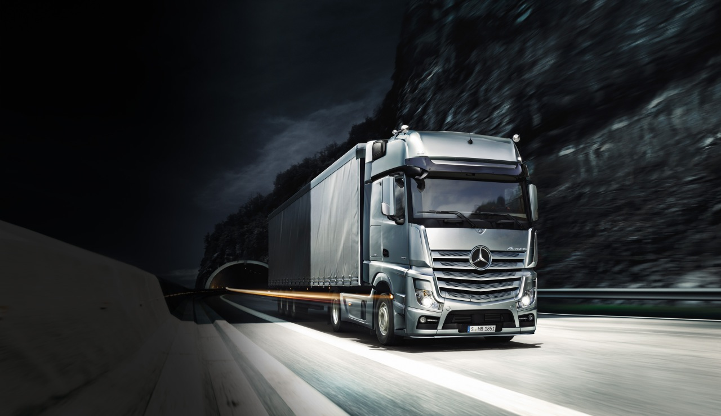
TEAM
R.A.Y.M.E
DYNAMIC REAL TIME COST EFFECTIVE ROUTING

Slide 2
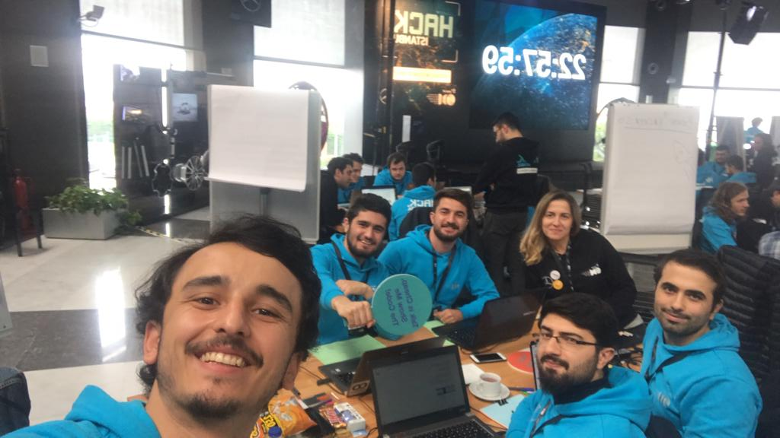

TEAM RAYME

Slide 3
WHAT IS THE PROBLEM?

Slide 4

WHAT IS THE PROBLEM?
INEFFICIENT
COSTING

Slide 5
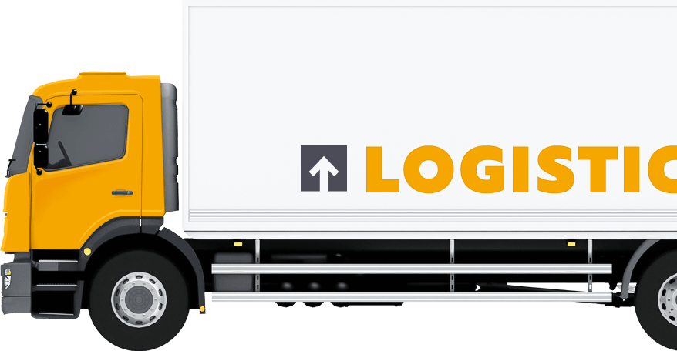
TARGET MARKET

Slide 6
SOLUTION?

Slide 7
SOLUTION?
TRUCK
MAPS(API)
CONNECTED
CAR
(MERCEDES API)

Slide 8
SOLUTION IS…
INNOVATIVE
ADAPTIVE
FEASIBLE

Slide 9
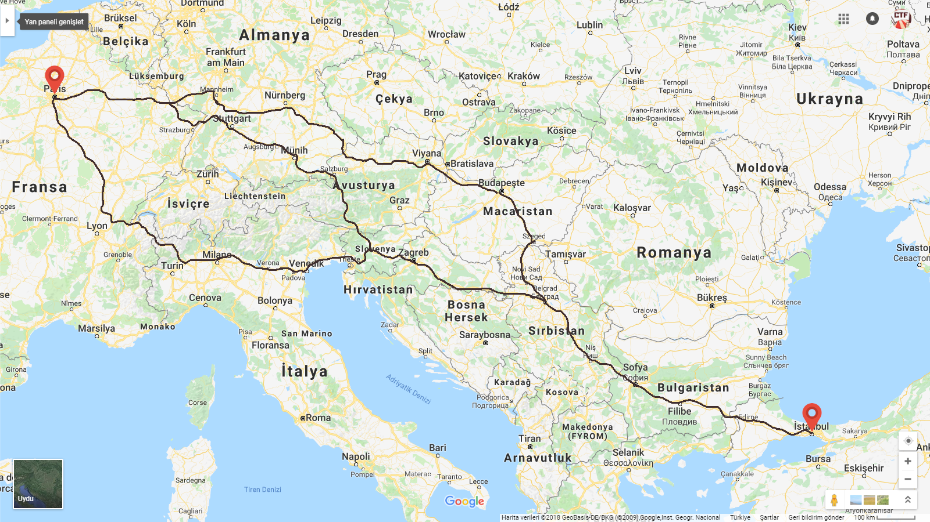

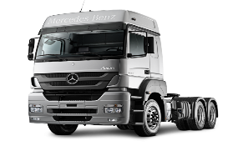
Traffic rate is high
There is a car accident

Slide 10
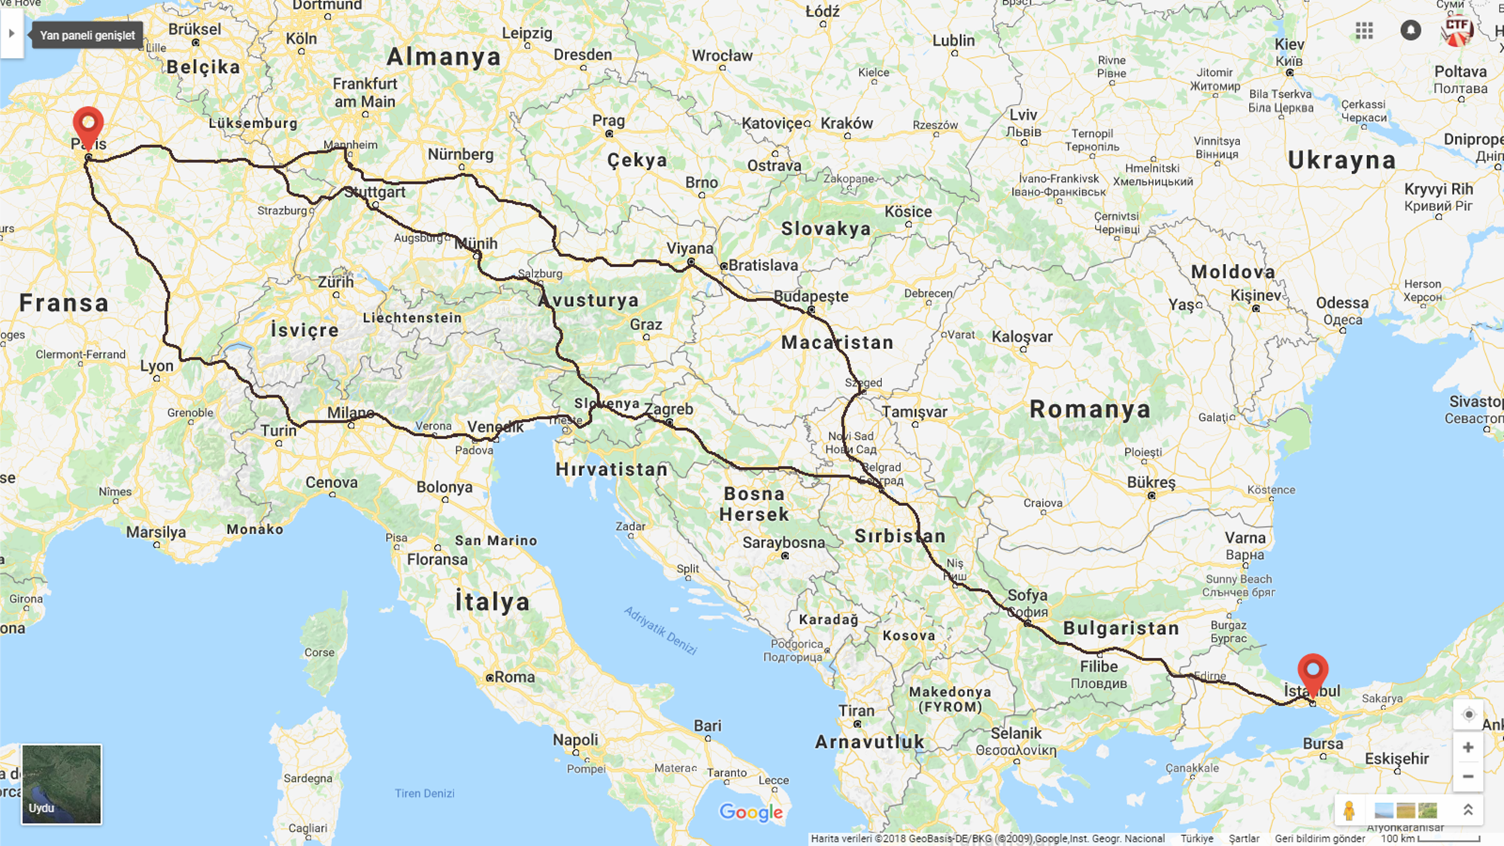


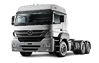
X
There is an equipment failure
Failure is fixed.
There is an equipment failure

Slide 11
REFERENCES
Truck routing and scheduling,
Csongor Gy. Csehi Mark Farkas
2014

